Slide 1
Artificial Neural Networks
Introduction, or how the brain works
The neuron as a simple computing element
The perceptron
Multilayer neural networks

Slide 2
Neural Networks and the Brain
A neural network is a model of reasoning inspired by the human brain.
The brain consists of a densely interconnected set of nerve cells, or basic information-processing units, called neurons.
The human brain incorporates nearly 10 billion neurons and 60 trillion connections, synapses, between them.
By using multiple neurons simultaneously, the brain can perform its functions much faster than the fastest computers in existence today.
Each neuron has a very simple structure, but an army of such elements constitutes a tremendous processing power.
A neuron consists of a cell body, soma, a number of fibers called dendrites, and a single long fiber called the axon.
Notes:
A neural network can be defined as a model of reasoning based on the human brain. The brain consists of a densely interconnected set of nerve cells, or basic information-processing units, called neurons.
The human brain incorporates nearly 10 billion neurons and 60 trillion connections, synapses, between them. By using multiple neurons simultaneously, the brain can perform its functions much faster than the fastest computers in existence today.
Each neuron has a very simple structure, but an army of such elements constitutes a tremendous processing power.
A neuron consists of a cell body, soma, a number of fibers called dendrites, and a single long fiber called the axon.

Slide 3
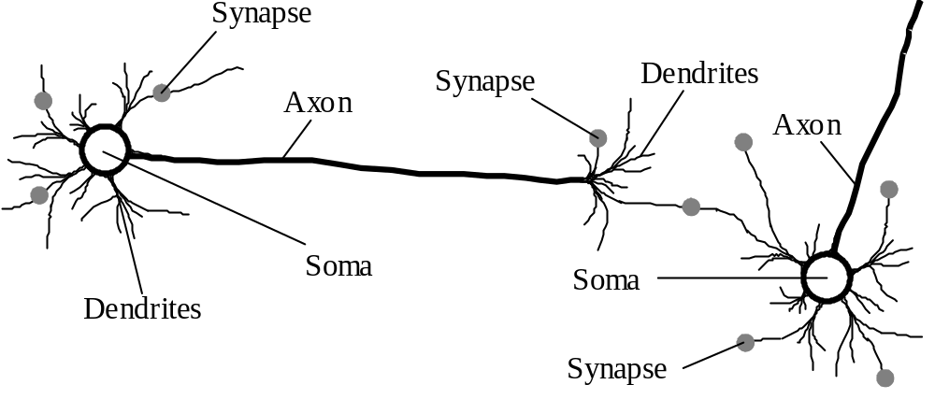
Biological neural network

Slide 4
Our brain can be considered as a highly complex, non-linear and parallel information-processing system.
Information is stored and processed in a neural network simultaneously throughout the whole network, rather than at specific locations. In other words, in neural networks, both data and its processing are global rather than local.
Learning is a fundamental and essential characteristic of biological neural networks. The ease with which they can learn led to attempts to emulate a biological neural network in a computer.
Notes:
<SKIP>

Slide 5
An artificial neural network consists of a number of very simple processors, also called neurons, which are analogous to the biological neurons in the brain.
The neurons are connected by weighted links passing signals from one neuron to another.
The output signal is transmitted through the neuron’s outgoing connection. The outgoing connection splits into a number of branches that transmit the same signal. The outgoing branches terminate at the incoming connections of other neurons in the network.
Notes:
<SKIP>

Slide 6
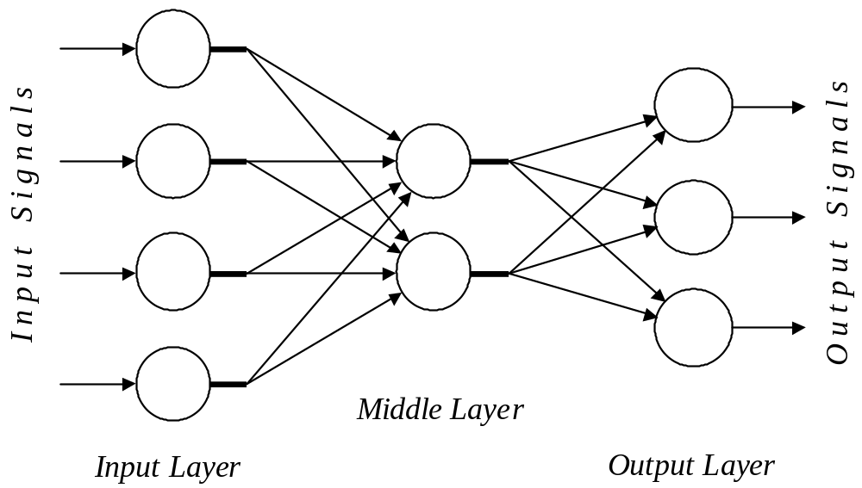
Architecture of a typical artificial neural network
Notes:
An artificial neural network consists of a number of very simple processors, also called neurons, which are analogous to the biological neurons in the brain.
The neurons are connected by weighted links passing signals from one neuron to another.
The output signal is transmitted through the neuron’s outgoing connection. The outgoing connection splits into a number of branches that transmit the same signal. The outgoing branches terminate at the incoming connections of other neurons in the network.

Slide 7
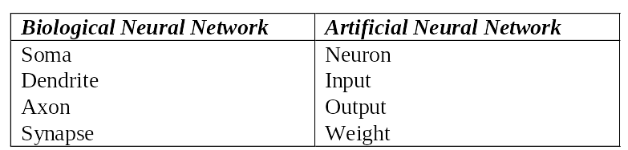
Analogy between biological and
artificial neural networks

Slide 8
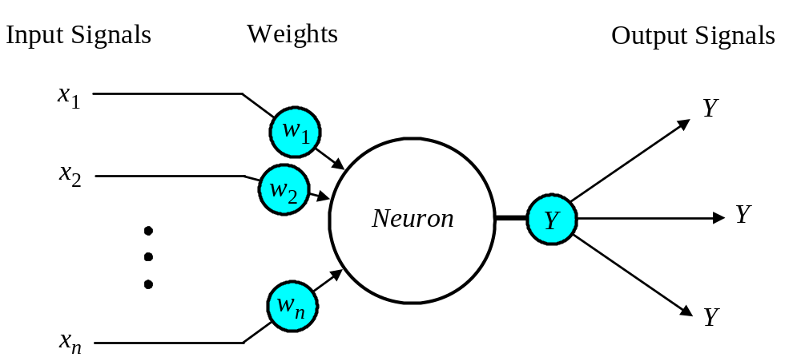
The neuron as a simple computing element
Diagram of a neuron

Slide 9
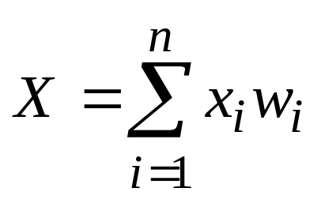
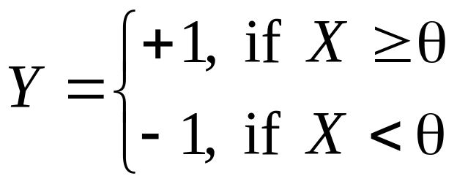
A Simple Activation Function – Sign Function
The neuron computes the weighted sum of the input signals and compares the result with a threshold value, θ.
If the net input is less than the threshold, the neuron output is –1.
if the net input is greater than or equal to the threshold, the neuron becomes activated and its output is +1.
The neuron uses the following transfer or activation function:
This type of activation function is called a sign function. (McCulloch and Pitts 1943)

Slide 10
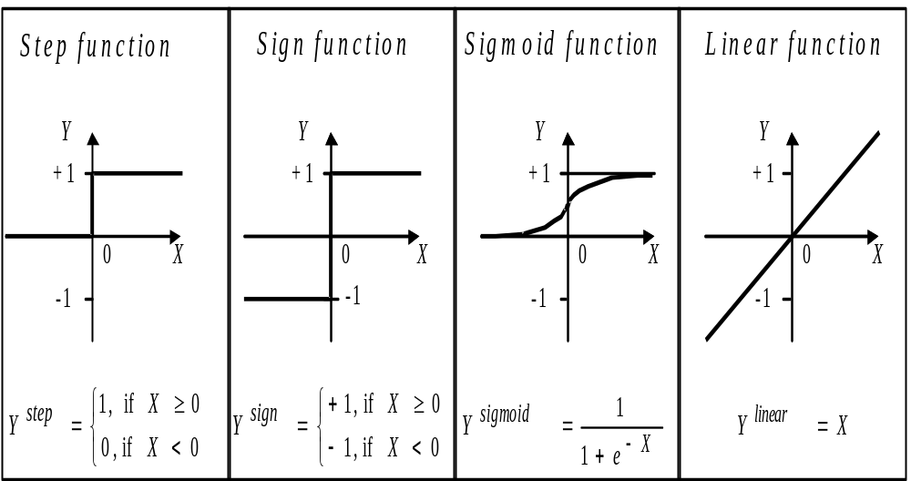
4 Common Activation functions of a neuron
Notes:
Step and Sign (“hard limit functions”) are often used in decision-making neurons for classification and pattern recognition tasks
Sigmoid function transforms all weighted inputs into the range 0-1. Used in back-propagation networks
Linear functions often used for linear approximations

Slide 11
Can a single neuron learn a task?
Start off with earliest/ simplest
  In 1958, Frank Rosenblatt introduced a training algorithm that provided the first procedure for training a simple ANN: a perceptron.
  The perceptron is the simplest form of a neural network. It consists of a single neuron with adjustable synaptic weights and a hard limiter.

Slide 12
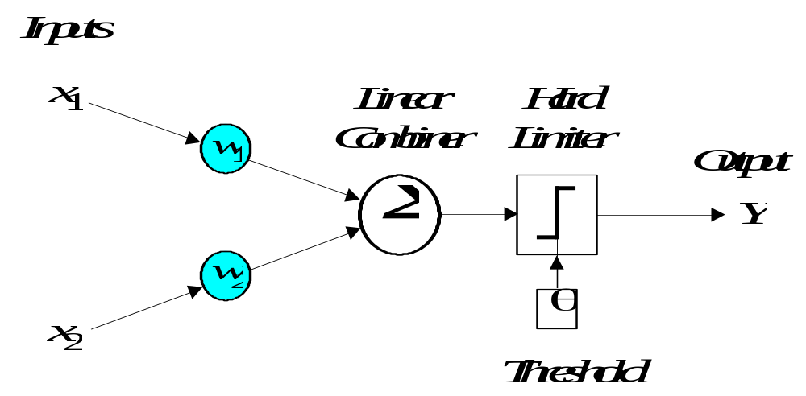
Single-layer two-input perceptron

Slide 13
The Perceptron
The operation of Rosenblatt’s perceptron is based on the McCulloch and Pitts neuron model. The model consists of a linear combiner followed by a hard limiter.
The weighted sum of the inputs is applied to the hard limiter, which produces an output equal to +1 if its input is positive and −1 if it is negative.

Slide 14
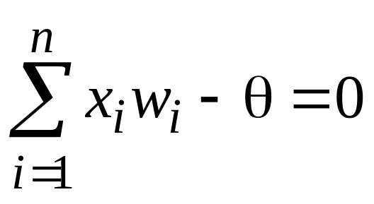
The aim of the perceptron is to classify inputs,
x₁, x₂, . . ., x_{n}, into one of two classes, say
A₁ and A₂.
In the case of an elementary perceptron, the n-dimensional space is divided by a hyperplane into two decision regions. The hyperplane is defined by the linearly separable function:

Slide 15
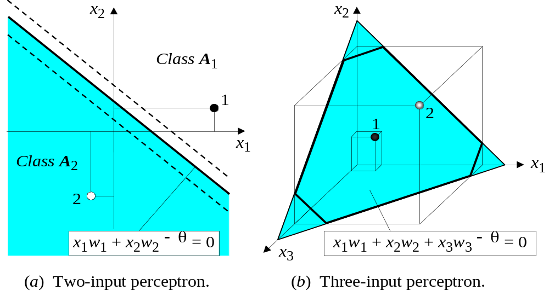
Linear separability in the perceptrons
Changing θ shifts the boundary
Notes:
… same principle for more dimensions (hyperplane) – but harder to draw and visualize

Slide 16
How does the perceptron learn its classification tasks?
making small adjustments in the weights
  to reduce the difference between the actual and desired outputs of the perceptron.
  Learns weights such that output is consistent with the training examples.
The initial weights are randomly assigned,
  usually in the range [−0.5, 0.5],
Notes:
This is done by making small adjustments in the weights to reduce the difference between the actual and desired outputs of the perceptron. The initial weights are randomly assigned, usually in the range [−0.5, 0.5], and then updated to obtain the output consistent with the training examples.

Slide 17
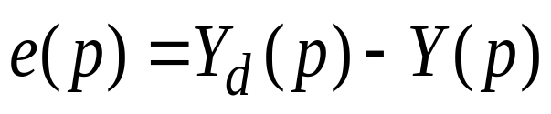
If at iteration p, the actual output is Y(p) and the desired output is Y_{d} (p), then the error is given by:
where p = 1, 2, 3, . . .
Iteration p here refers to the pth training example presented to the perceptron.
If the error, e(p), is positive, we need to increase perceptron output Y(p), but if it is negative, we need to decrease Y(p).

Slide 18
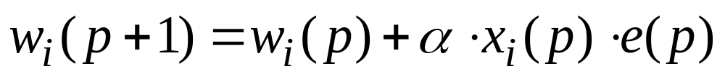
The perceptron learning rule
where p is iteration # = 1, 2, 3, . . .
α is the learning rate, a positive constant less than unity (1).
Intuition:
  Weight at next iteration is based on an adjustment from the current weight
  Adjustment amount is influenced by the amount of the error, the size of the input, and the learning rate
  Learning rate is a free parameter that must be “tuned”
The perceptron learning rule was first proposed by Rosenblatt in 1960.
Using this rule we can derive the perceptron training algorithm for classification tasks.

Slide 19
Perceptron’s training algorithm
Step 1: Initialisation
Set initial weights w₁, w₂,…, w_{n} and threshold θ to random numbers in the range [−0.5, 0.5].
(during training, If the error, e(p), is positive, we need to increase perceptron output Y(p), but if it is negative, we need to decrease Y(p).)

Slide 20
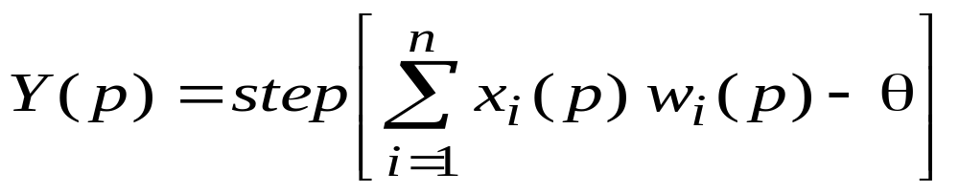
Perceptron’s training algorithm (continued)
Step 2: Activation
Activate the perceptron by applying inputs x₁(p), x₂(p),…, x_{n}(p) and desired output Y_{d} (p). Calculate the actual output at iteration p = 1
where n is the number of the perceptron inputs, and step is a step activation function.

Slide 21
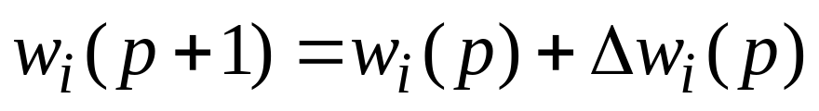
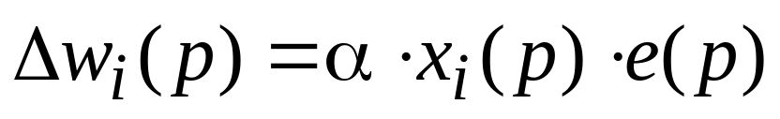
Perceptron’s training algorithm (continued)
Step 3: Weight training
Update the weights of the perceptron
where Δ w_{i} (p) is the weight correction for weight i at iteration p.
The weight correction is computed by the delta rule:
Step 4: Iteration
Increase iteration p by one, go back to Step 2 and repeat the process until convergence.

Slide 22
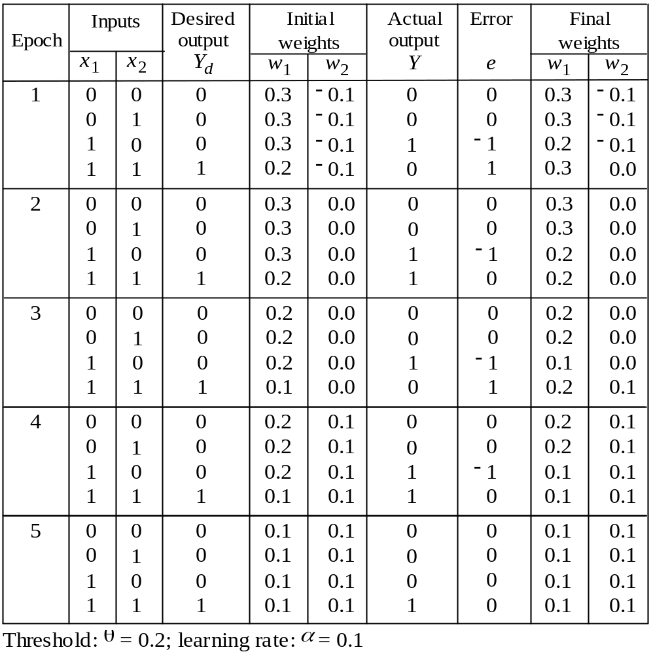
Example of perceptron learning: the logical operation AND
Notes:
See PerceptronLearningAND.xls <Make available>

Slide 23
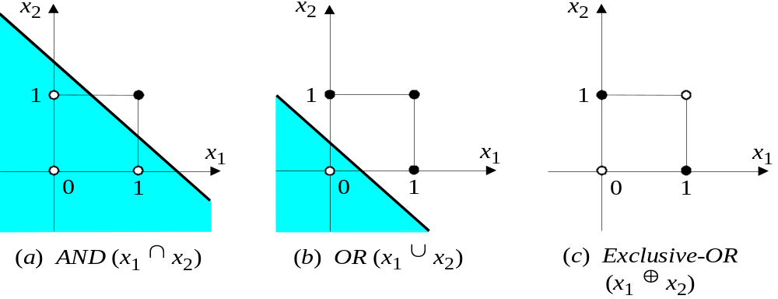
Two-dimensional plots of basic logical operations
A perceptron can learn the operations AND and OR, but not Exclusive-OR.
Exclusive-OR is NOT linearly separable
This limitation stalled neural network research for more than a decade

Slide 24
Multilayer neural networks
A multilayer perceptron is a feedforward neural network with one or more hidden layers.
The network consists of an input layer of source neurons, at least one middle or hidden layer of computational neurons, and an output layer of computational neurons.
The input signals are propagated in a forward direction on a layer-by-layer basis.

Slide 25
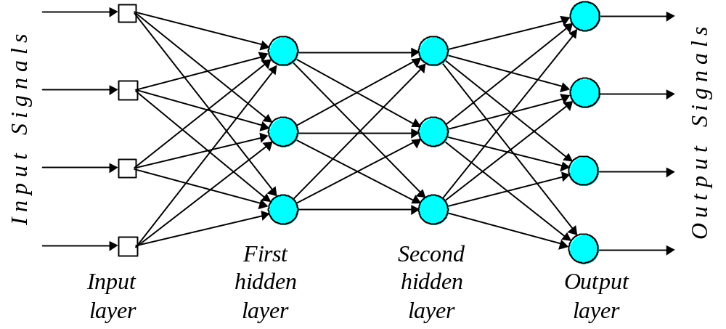
Multilayer perceptron with two hidden layers

Slide 26
What does the middle layer hide?
A hidden layer “hides” its desired output.
Neurons in the hidden layer cannot be observed through the input/output behaviour of the network.
There is no obvious way to know what the desired output of the hidden layer should be.
Commercial ANNs incorporate three and sometimes four layers, including one or two hidden layers.
  Each layer may contain from 10 to 1000 neurons.
Experimental neural networks may have five or even six layers, including three or four hidden layers, and utilise millions of neurons.
Notes:
<SKIP>
A hidden layer “hides” its desired output. Neurons in the hidden layer cannot be observed through the input/output behaviour of the network. There is no obvious way to know what the desired output of the hidden layer should be.
Commercial ANNs incorporate three and sometimes four layers, including one or two hidden layers. Each layer can contain from 10 to 1000 neurons. Experimental neural networks may have five or even six layers, including three or four hidden layers, and utilise millions of neurons.

Slide 27
Hidden Layer
Detects features in the inputs – hidden patterns
With one hidden layer, can represent any continuous function of the inputs
With two hidden layers even discontinuous functions can be represented

Slide 28
Back-propagation neural network
Most popular of 100+ ANN learning algorithms
Learning in a multilayer network proceeds the same way as for a perceptron.
A training set of input patterns is presented to the network.
The network computes its output pattern, and if there is an error − or in other words a difference between actual and desired output patterns − the weights are adjusted to reduce this error.
The difference is in the number of weights and architecture …

Slide 29
Back-propagation neural network
In a back-propagation neural network, the learning algorithm has two phases:
  a training input pattern is presented to the network input layer.
    The network propagates the input pattern from layer to layer until the output pattern is generated by the output layer.
    Activation function generally sigmoid
  If this pattern is different from the desired output, an error is calculated and then propagated backwards through the network from the output layer to the input layer. The weights are modified as the error is propagated.
Notes:
In a back-propagation neural network, the learning algorithm has two phases.
First, a training input pattern is presented to the network input layer. The network propagates the input pattern from layer to layer until the output pattern is generated by the output layer.
If this pattern is different from the desired output, an error is calculated and then propagated backwards through the network from the output layer to the input layer. The weights are modified as the error is propagated.

Slide 30
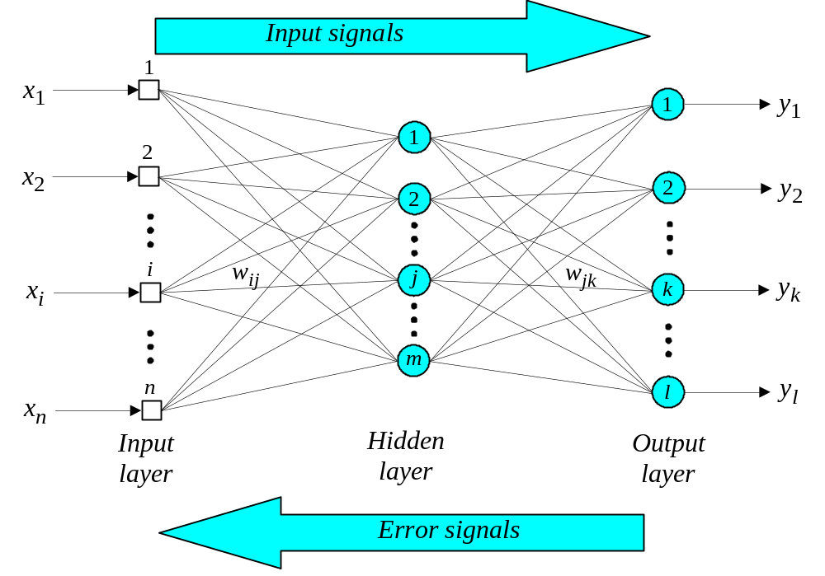
Three-layer back-propagation neural network
Notes:
TYPICALLY NETWORK IS FULLY CONNECTED

Slide 31
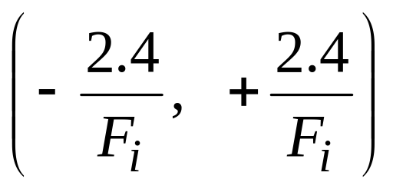
The back-propagation training algorithm
Step 1: Initialisation
Set all the weights and threshold levels of the network to random numbers uniformly distributed inside a small range:
where F_{i} is the total number of inputs of neuron i in the network. The weight initialisation is done on a neuron-by-neuron basis.

Slide 32
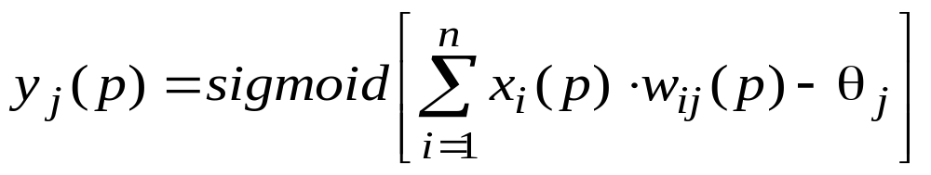
Step 2: Activation
Activate the back-propagation neural network by applying inputs x₁(p), x₂(p),…, x_{n}(p) and desired outputs y_{d,1}(p), y_{d,2}(p),…, y_{d,n}(p).
(a) Calculate the actual outputs of the neurons in the hidden layer:
where n is the number of inputs of neuron j in the hidden layer, and sigmoid is the sigmoid activation function.

Slide 33
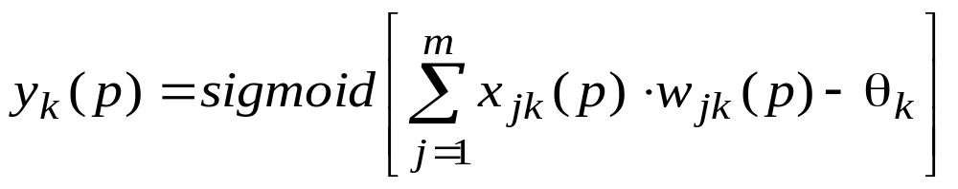
Step 2: Activation (continued)
(b) Calculate the actual outputs of the neurons in the output layer:
where m is the number of inputs of neuron k in the output layer.

Slide 34
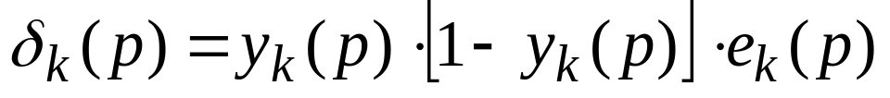
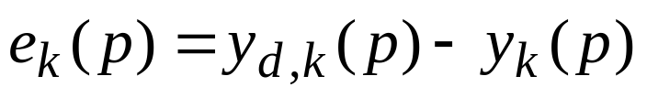
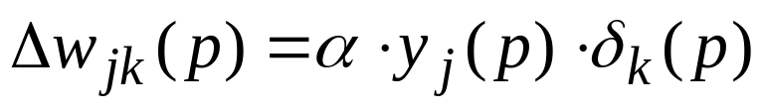
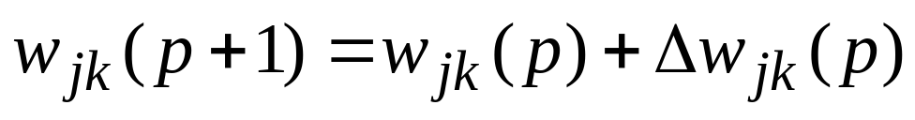
Step 3: Weight training
Update the weights in the back-propagation network propagating backward the errors associated with output neurons.
(a) Calculate the error gradient for the neurons in the output layer:
where (error at output unit k)
Calculate the weight corrections:
(weight change for j to k link)
Update the weights at the output neurons:
Notes:
<SKIP THE MATH >
Error gradient for this output node = Output of output node * (1 – output of output node) * error
<the “Output of output node * (1 – output of output node) “ is the derivative of the sigmoid function>
Error = desired (correct) output – calculated output
Delta = learning rate * output of hidden node * error gradient for the output node
New weight = old weight + delta

Slide 35
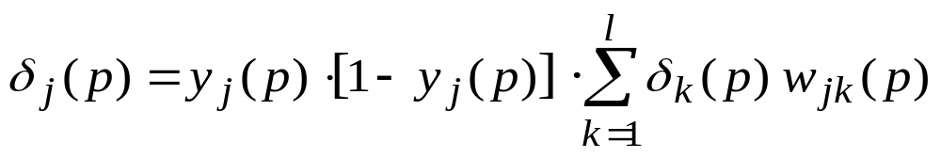
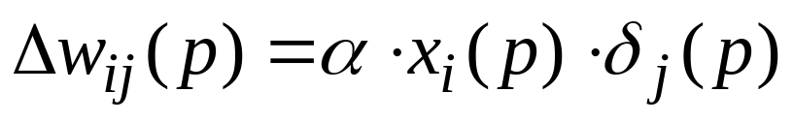
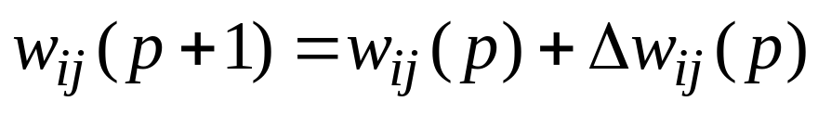
Step 3: Weight training (continued)
(b) Calculate the error gradient for the neurons in the hidden layer:
Calculate the weight corrections:
Update the weights at the hidden neurons:
Notes:
<SKIP THE MATH >
Error gradient for this hidden node = Output of hidden node * (1 – output of hidden node) * SUMofAllOutputNodes ( error gradient of output node * weightfromHiddentoOutput)
Delta = Learning rate * input node * error gradient for this hidden node
New weight = old weight + delta

Slide 36
Step 4: Iteration
Increase iteration p by one, go back to Step 2 and repeat the process until the selected error criterion is satisfied.

Slide 37
Example
network is required to perform logical operation Exclusive-OR.
Recall that a single-layer perceptron could not do this operation.
Now we will apply the three-layer back-propagation network
See BackPropLearningXor.xls
Notes:
<SKIP THE MATH - don’t use the spreadsheet>
As an example, we may consider the three-layer back-propagation network. Suppose that the network is required to perform logical operation Exclusive-OR. Recall that a single-layer perceptron could not do this operation. Now we will apply the three-layer net.

Slide 38
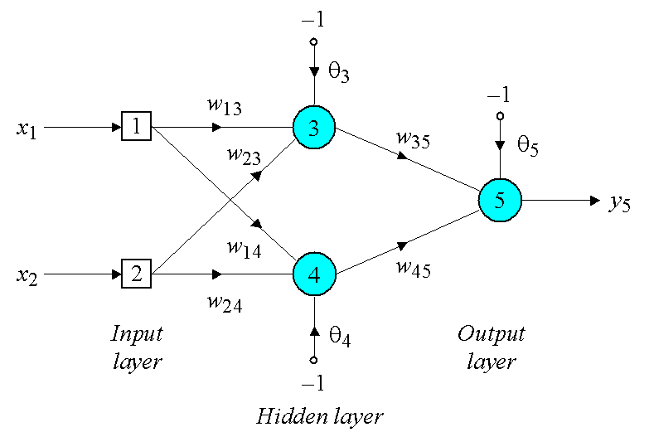
Three-layer network for solving the Exclusive-OR operation

Slide 39
Example (con)
The effect of the threshold applied to a neuron in the hidden or output layer is represented by its weight, θ, connected to a fixed input equal to −1.
The initial weights and threshold levels are set randomly as follows:
w₁₃ = 0.5, w₁₄ = 0.9, w₂₃ = 0.4, w₂₄ = 1.0, w₃₅ = −1.2, w₄₅ = 1.1, θ₃ = 0.8, θ₄ = −0.1 and θ₅ = 0.3.

Slide 40

Example (con)
First training example - inputs x₁ and x₂ = 1 and desired output y_{d,5} is 0.
actual outputs of neurons 3 and 4 in the hidden layer are calculated as:
Now the actual output of neuron 5 in the output layer is determined as:
Thus, the following error is obtained:
Notes:
<SKIP THE MATH >

Slide 41
Example (con)
The next step is weight training.
To update the weights and threshold levels in our network, we propagate the error from the output layer backward to the input layer.
First, we calculate the error gradient for neuron 5 in the output layer:
Then we determine the weight corrections assuming that the learning rate parameter, α, is equal to 0.1:
Notes:
<SKIP THE MATH >

Slide 42
Example (con)
Next we calculate the error gradients for neurons 3 and 4 in the hidden layer:
We then determine the weight corrections:
Notes:
<SKIP THE MATH >

Slide 43
Example (con)
At last, we update all weights and threshold:
w
=
w
+
Δ
w
=
0
.
5
+
0
.
0038
=
0
.
5038
13
13
13
w
=
w
+
Δ
w
=
0
.
9
−
0
.
0015
=
0
.
8985
14
14
14
w
=
w
+
Δ
w
=
0
.
4
+
0
.
0038
=
0
.
4038
23
23
23
w
=
w
+
Δ
w
=
1
.
0
−
0
.
0015
=
0
.
9985
24
24
24
w
=
w
+
Δ
w
=
−
1
.
2
−
0
.
0067
=
−
1
.
2067
35
35
35
w
=
w
+
Δ
w
=
1
.
1
−
0
.
0112
=
1
.
0888
45
45
45
θ
=
θ
+
Δ
θ
=
0
.
8
−
0
.
0038
=
0
.
7962
3
3
3
θ
=
θ
+
Δ
θ
=
−
0
.
1
+
0
.
0015
=
−
0
.
0985
4
4
4
θ
=
θ
+
Δ
θ
=
0
.
3
+
0
.
0127
=
0
.
3127
5
5
5
The training process is repeated until the sum of squared errors is less than 0.001.
Notes:
<SKIP THE MATH >
(an arbitrary threshold – could be for N epochs, or until sum of squared errors stops decreasing … )

Slide 44
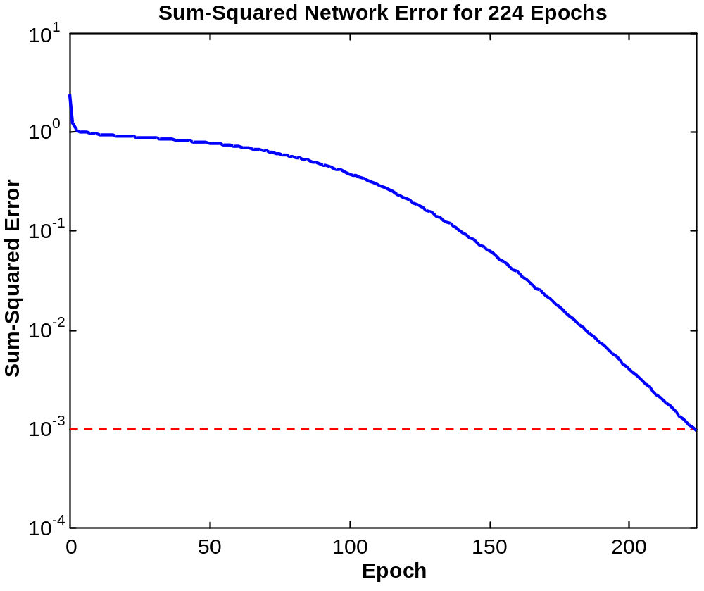
Learning curve for operation Exclusive-OR
Notes:
224 Epochs!!!

Slide 45
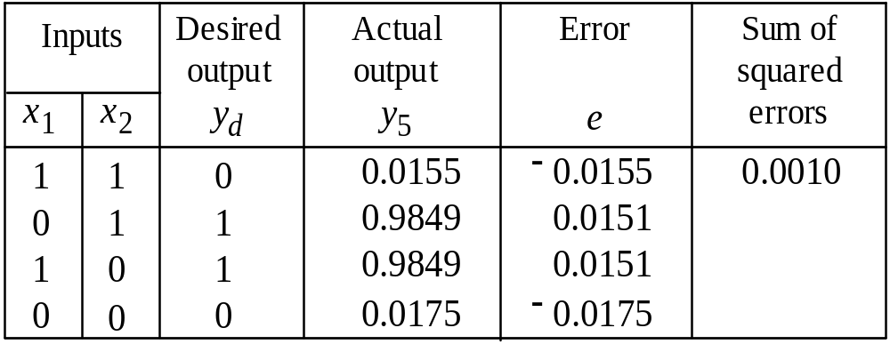
Final results of three-layer network learning

Slide 46
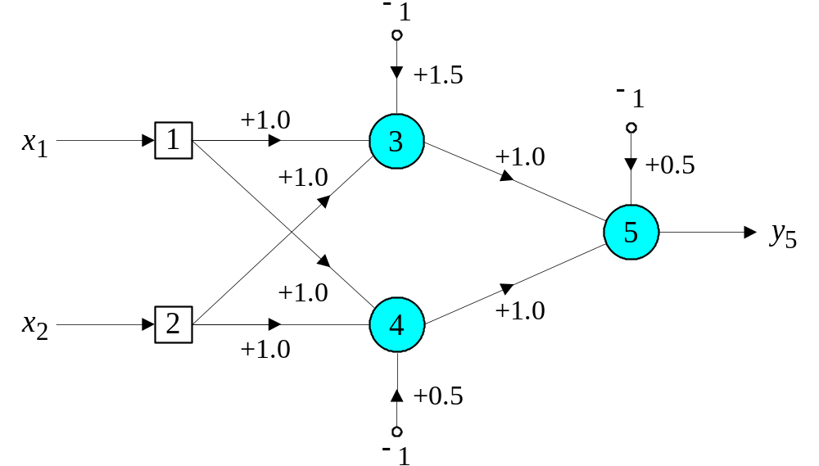
Network represented by McCulloch-Pitts model for solving the Exclusive-OR operation
-1.0
Notes:
The slide was slightly wrong
If w3,5 is -1
Inputs Node3 Node4 Node5
1 1 ➔ 1+1 -1.5 = 0.5 ➔ 1 1+1 -.5 = 1.5 ➔ 1 -1+1 -.5 = -0.5 ➔ -1
1 0 ➔ 1+0 -1.5 = -.5 ➔ -1 1+0 -.5 = .5 ➔ 1 1+1 -.5 = 1.5 ➔ 1
0 1 ➔ 0+1 -1.5 = -.5 ➔ -1 0+1 -.5 = .5 ➔ 1 1+1 -.5 = 1.5 ➔ 1
0 0 ➔ 0+0 -1.5 = -1.5 ➔ -1 0+0 -.5 = -.5 ➔ -1 1+-1 -.5 = -0.5 ➔ -1
Slide version:
Inputs Node3 Node4 Node5
1 1 ➔ 1+1 -1.5 = 0.5 ➔ 1 1+1 -.5 = 1.5 ➔ 1 1+1 -.5 = 1.5 ➔ 1
1 0 ➔ 1+0 -1.5 = -.5 ➔ -1 1+0 -.5 = .5 ➔ 1 -1+1 -.5 = -.5 ➔ -1
0 1 ➔ 0+1 -1.5 = -.5 ➔ -1 0+1 -.5 = .5 ➔ 1 -1+1 -.5 = -.5 ➔ -1
0 0 ➔ 0+0 -1.5 = -1.5 ➔ -1 0+0 -.5 = -.5 ➔ -1 -1+-1 -.5 = -2.5 ➔ -1

Slide 47
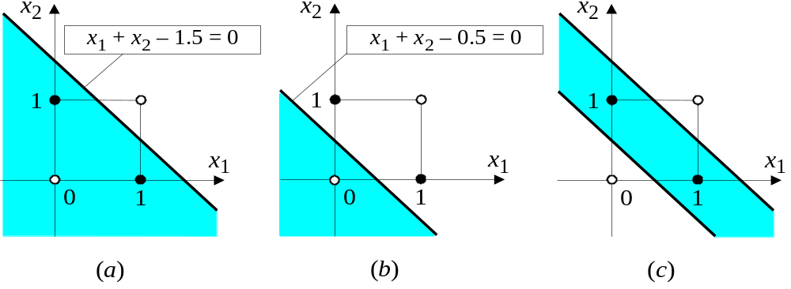
Decision boundaries
(a) Decision boundary constructed by hidden neuron 3;
(b) Decision boundary constructed by hidden neuron 4; (c) Decision boundaries constructed by the complete
three-layer network
Notes:
Above the line is true
Above the line is true
by negating first with -1, below (a) AND above (b) is true

Slide 48
Neural Nets in Weka
Xor – with default hidden layer
Xor – with two hidden nodes
Basketball Class
Broadway Stratified – default
Broadway Stratified – 10 hidden nodes

Slide 49
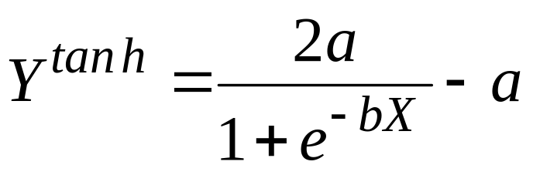
Accelerated learning in multilayer neural networks
A multilayer network learns much faster when the sigmoidal activation function is represented by a hyperbolic tangent:
where a and b are constants.
Suitable values for a and b are:
a = 1.716 and b = 0.667

Slide 50
Accelerated learning in multilayer neural networks
We also can accelerate training by including a momentum term in the delta rule:
where β is a positive number (0 ≤ β < 1) called the momentum constant. Typically, the momentum constant is set to 0.95.
This iteration’s change in weight is influenced by last iteration’s change in weight !!!
This equation is called the generalised delta rule.
Basic version
Notes:
… if beta is zero then this equals the basic version

Slide 51
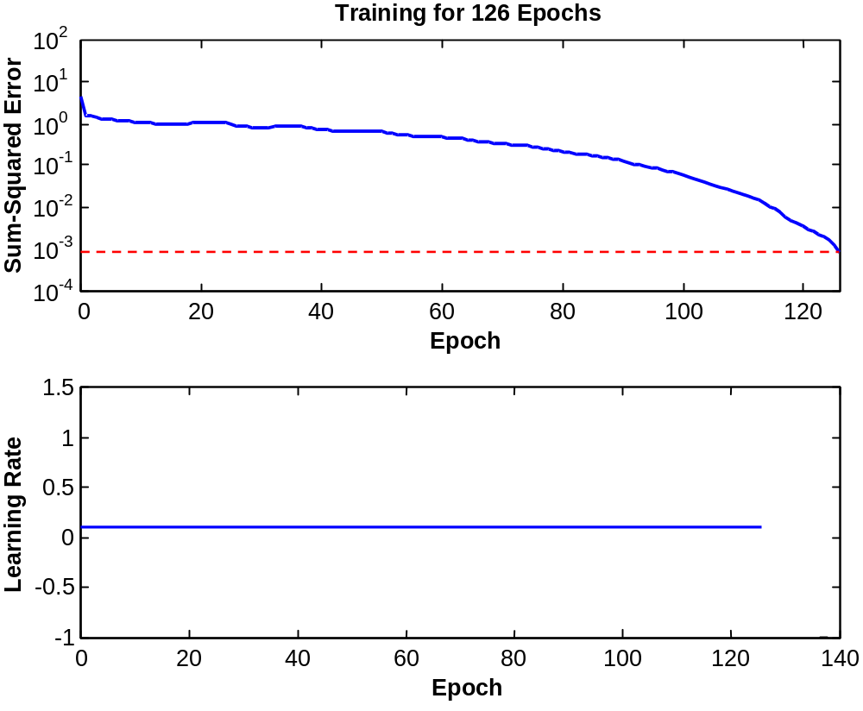
Learning with momentum for operation Exclusive-OR

Slide 52
Learning with adaptive learning rate
To accelerate the convergence and yet avoid the
danger of instability, we can apply two heuristics:
Heuristic 1
If the change of the sum of squared errors has the same algebraic sign for several consequent epochs, then the learning rate parameter, α, should be increased.
Heuristic 2
If the algebraic sign of the change of the sum of squared errors alternates for several consequent epochs, then the learning rate parameter, α, should be decreased.

Slide 53
Learning with adaptive learning rate (con)
If the sum of squared errors at the current epoch exceeds the previous value by more than a predefined ratio (typically 1.04), the learning rate parameter is decreased (typically by multiplying by 0.7) and new weights and thresholds are calculated.
If the error is less than the previous one, the learning rate is increased (typically by multiplying by 1.05).

Slide 54
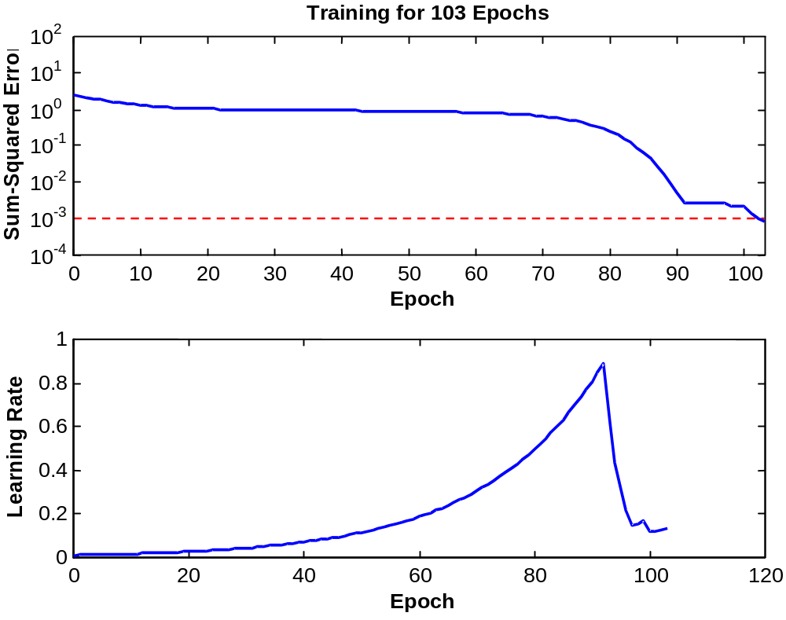
Learning with adaptive learning rate

Slide 55
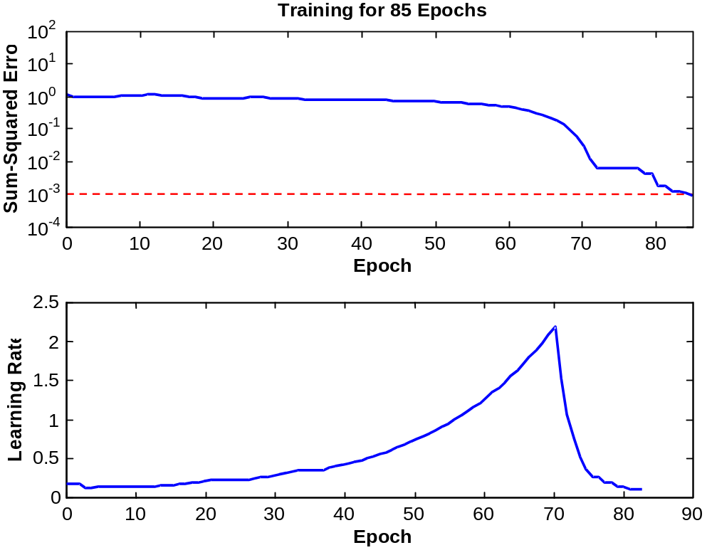
Learning with momentum and adaptive learning rate

